Slide 2

Chapter Resource Slideshow
You may delete this slide and begin with the next slide

Slide 3
University/College Name
NAfME Collegiate Chapter #xx
Enter Division Here Division
To find division, click here. To inquire about Chapter #, please email collegiate@nafme.org.
Delete this box before presenting.

Slide 4
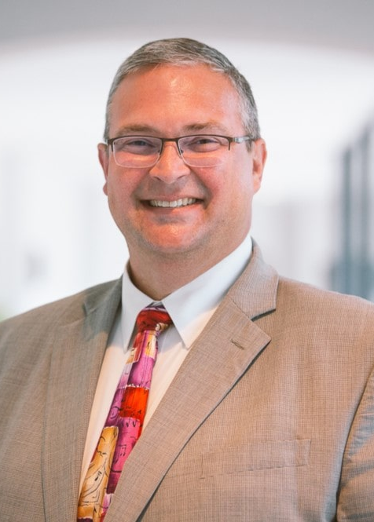
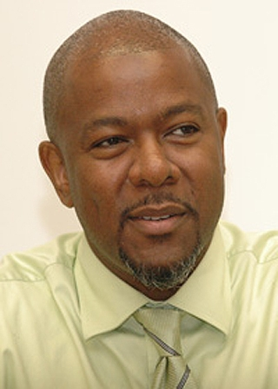
NAfME National Leadership
Scott R. Sheehan
NAfME Immediate Past President
2024-2026
Cecil Adderley
NAfME President
2025-2028

Slide 5
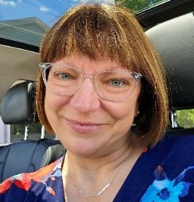
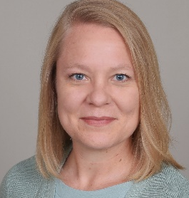
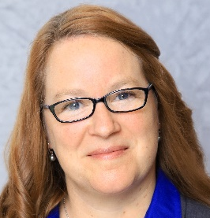
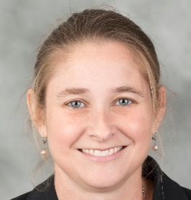
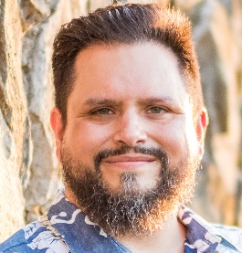
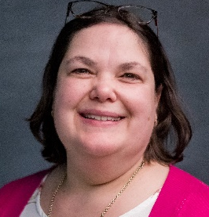
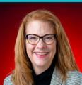
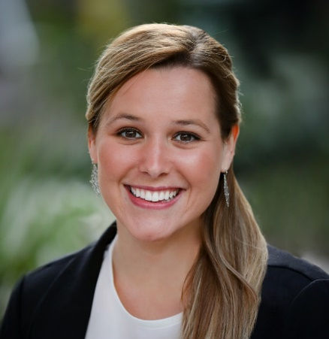
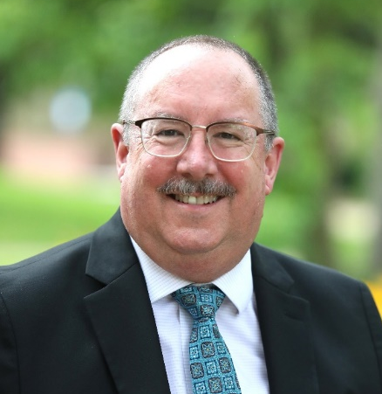
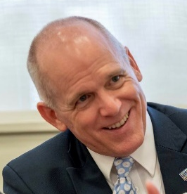
Heidi J. Welch
Eastern Division
Representative
Jill Wilson
North Central Division Representative
Lori Gray
Northwest Division Representative
Debbie S. O’Connell
Southern Division
Representative
Collegiate Advisory Council
Brett Martinez
Southwestern Division Representative
Michelle McConkey
Western Division Representative
Susan L. Smith
Past Chair
Katrina Cox
Council Co-Chair
Steve Kelly
Council Co-Chair
Scott Hedgecock
National Executive Board
Liaison

Slide 6
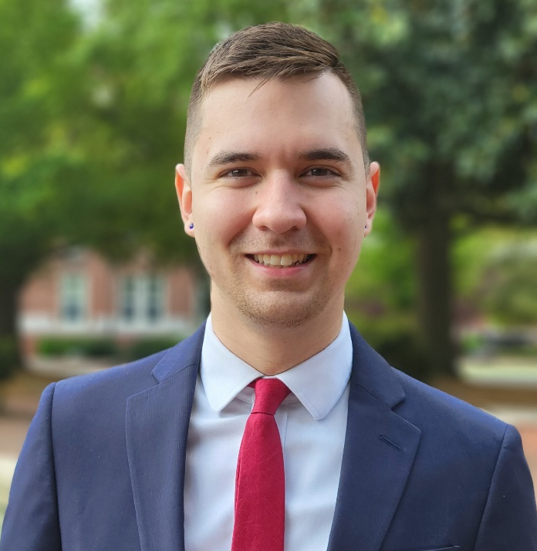
NAfME Collegiate Program Manager
Ben Reyes
NAfME Membership Manager
Collegiate Program Manager
benr@nafme.org

Slide 7
Chapter Advisor
Add picture here
Click Outline of Box
Click Shape Format in top ribbon
Click Shape Fill
Click Picture
If too much stretching/distorting of image occurs when selecting your picture, you may alternatively use the cropping method: tutorial here.
Chapter Advisor Name
Title
Email Address

Slide 8
Student Leadership
Add picture here
Click Outline of Box
Click Shape Format in top ribbon
Click Shape Fill
Click Picture
If too much stretching/distorting of image occurs when selecting your picture, you may alternatively use the cropping method: tutorial here.
Student Name
President
Email Address
Student Name
Vice President
Email Address
Student Name
Secretary
Email Address
Student Name
Treasurer
Email Address
Adjust according to your chapter needs; delete this box before presenting

Slide 9
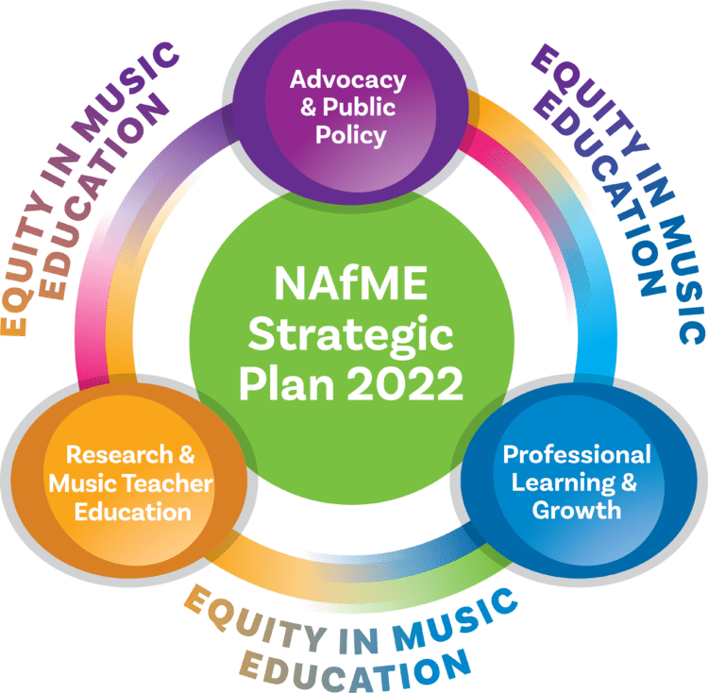
NAfME Strategic Plan
MISSION
NAfME is a collaborative community that supports music educators and advocates for equitable access to music education.
VISION
NAfME is an association where all people are heard, seen, and feel they belong throughout their lifelong experiences in music.
BELIEF STATEMENT
Music is unique to the human experience and is essential to our humanity.
  Music communicates and connects people across all time and cultures.
  Music unlocks human creative expression and is a lens to the experiences and interpretations of the world.
  Music is basic to human wholeness through our emotions, intellect, and physical and spiritual well-being.
View Strategic Plan

Slide 10
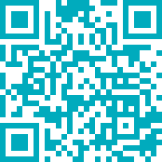
How to Join/Renew!
Scan the QR Code or visit
https://nafme.org/membership/join/
Chapters in FL, IN, PA and Western/India must Join/Renew via State MEA Website.
Links to these websites can be found at
https://nafme.org/membership/join/

Slide 11
Collegiate Membership Period
Collegiate Membership begins July 1 and ends June 30 of the following year
Joining after July 1 will still provide you access to all materials up to your join/renewal date
Ex. If you join/renew in September, you will still have access to July and August issues of Teaching Music magazine, webinars, etc.

Slide 12
Collegiate Membership Benefits
FREE PROFESSIONAL DEVELOPMENT
The NAfME Academy and NAfME Learning Center—free to members only—provide hours of free, high-quality webinars, discussions, and virtual events.
FREE ACCESS TO JOURNALS/PUBLICATIONS
Membership includes access to published articles and journals including Music Educators Journal, Journal of Research in Music Education, Journal of General Music Education, Journal of Music Teacher Education, and UPDATE: Applications of Research in Music Education.
NAfME Connect: FREE ONLINE COMMUNITY FOR NAfME MEMBERS
Connect serves as a gateway for connecting with music educators across the world. Have a specific question for other Collegiate members? Post it on Connect! Want to get a seasoned music educator’s perspective on a topic or resource? Post it on Connect! This tool is invaluable for networking and growth and is available to all NAfME members.
ADVOCACY TOOLS
NAfME provides tools and resources for its members to advocate for the music education profession at the local, state, and national levels. Visit the Advocacy Resource Center via the NAfME Website to begin learning how you can contribute to the future of the profession.
COLLEGIATE LEADERSHIP ADVOCACY SUMMIT
Join other NAfME Collegiate members on a multi-day event in Washington, D.C. advocating for music education and attending invaluable leadership presentations from leaders across the country.
INTRODUCTORY MEMBER PRICING
Collegiate Members active their final year of their studies will receive 50% off full NAfME membership their first year of teaching. Contact memberservices@nafme.org to receive this special discount!

Slide 13
Chapter of Excellence Recognition
The Chapter of Excellence Recognition was developed to encourage chapters to plan and execute successful Advocacy Projects, Music Programs, Professional Development Projects, Recruitment Strategies, and Service Projects. Recognition of excellent projects is conferred annually and is based on activities completed by the chapter during the Spring, Summer, or Fall 2025 semesters, or the Spring 2026 semester.
Chapter of Excellence Categories
Advocacy
A project promoting the importance of music education for all, or to assist in an advocacy effort taking place in their community. Examples of projects can include social media campaigns and student-led advocacy training sessions
Music Program
A music performance organized and/or presented by the chapter
Professional Development
A project organized and/or presented by the chapter to further the professional development of its members
Service
A project organized and carried out by the chapter to benefit music education at large or music or music education programs in the community
Recruitment Strategy
A successful strategy to recruit students to join the chapter
Criteria for Chapter of Excellence Selection
Chapter Participation, Commitment, Creativity, Impact, Organization, Uniqueness, and Visibility.

Slide 14
Professional Achievement Award
The purpose of the Professional Achievement Award is to recognize individual Collegiate members for their commitment and dedication to NAfME and music education. This recognition is given to Collegiate members who have served their chapters in an exemplary manner. All Collegiate members who meet the following criteria are eligible to receive this distinction.
Criteria (all requirements apply)
Subject to change; check nafme.org/collegiate for latest information
Student must be currently enrolled in an active NAfME Collegiate chapter.
2. Student must also have been a Collegiate member of NAfME in the school year prior to the current one.
3. Student must possess an overall minimum grade point average of 3.0 (on a 4.0 scale) or equivalent in their content area during the year of the application.
4. Student must verify participation and involvement in chapter activities.

Slide 15
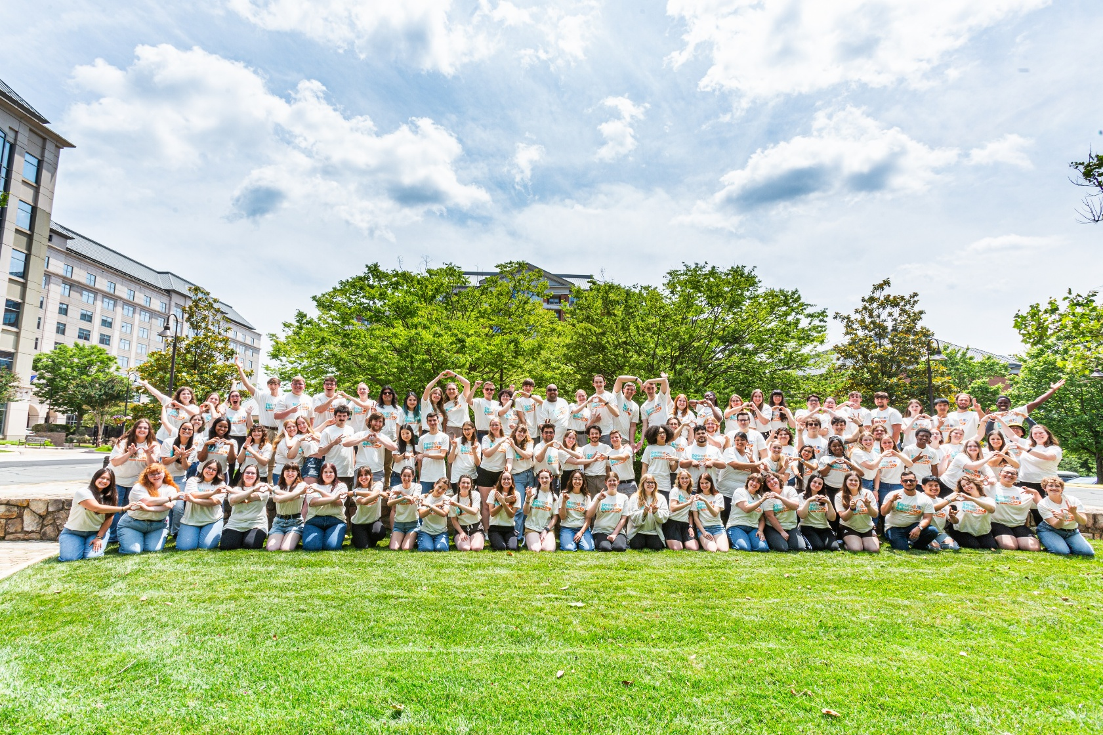
Collegiate Leadership Advocacy Summit
NAfME Collegiate members together annually during the summer for the College Leadership Summit. This summit is an opportunity to network and collaborate with fellow music education majors from around the United States. We hope all chapters are represented among the attendees at the summit.

Slide 16
20xx Recruitment Goals
Increase Membership to xx
Host xx Recruitment Events
  Recruitment Event Idea
  Recruitment Event Idea
  Recruitment Event Idea
Remember, NAfME Membership is not limited to only current/future in-service teachers. Invite all music majors to your chapter as all musicians will likely be educators in some manner. Affiliation with a professional organization can enhance one’s access to resources and provides a community to which they can belong.
You may delete this box prior to sharing.

Slide 17
20xx Fundraising Goals
$0.00
Host xx Fundraising Events
  Recruitment Event Idea
  Recruitment Event Idea
  Recruitment Event Idea
Funding Purposes
  Attend Collegiate Leadership Advocacy Summit
  Attend State MEA Conference
  Design/purchase shirts for the chapter

Slide 18
20xx Service Goals
Host xx Service Events
  Service/Volunteering Event Idea
  Service/Volunteering Event Idea
  Service/Volunteering Event Idea

Slide 19

Contact Us
Phone:
  800-336-3768
Business Hours:
  Monday – Friday 8AM - 4:30 PM ET
Member Services:
  Monday – Friday 9AM – 7:00 PM ET
Collegiate:
  collegiate@nafme.org
  Instagram: @nafmecollegiateofficial
  Facebook: facebook.com/cnafme

